Slide 1


1095-B Tax Form Team Norms
Backlog grooming– January 25th
1￼

Slide 2
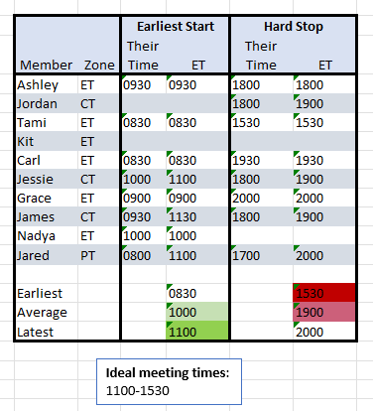
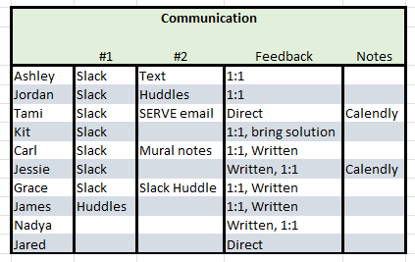
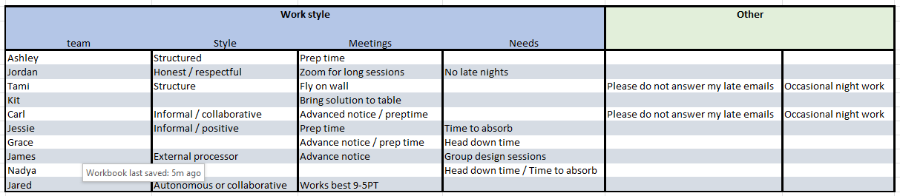
In your voice….
Let’s meet up…
Contact me …
I work best by…
2￼

Slide 3




The voice of our customer….
Let’s onboard to CEDAR…
Every CEDAR team member must initiate the PIV process within the first 3 days of onboarding
4 forms
Fingerprinting
TMS training certificate (1 hr)
Security Clearance
Your CSM will notify you when you need to start watching your email for eQip security processing notification.
Once adjudicated, you will be directed to make an appointment at your local VA to get PIV card
Withing 3-7 business days, you will be given access to VA network
Let’s learn…
Every team member must complete VA Platform Onboarding. Checklist will be assigned in ZenHub once give vets-write-all access to GitHub. Check list includes historical and procedural readings, mandatory meetings / introductions, directions on how to gain access to specific building or design tools, and position specific content.
Let’s meet up…
VA-PO has calendar url in VA Slack profile
It is most convenient to access Zoom meetings if initiated from a corporate Zoom account directly linked to Outlook 360.
Let’s chat…
The VA builds in the open. It is preferred that all conversations occur in VA 1095-B slack channel
3￼

Slide 4

The voice of our customer…. (cont.)
Let’s stay organized…
Please link thoughts / conversations / document discussions using SLACK threads
It is most convenient to access Zoom meetings if initiated from a corporate Zoom account directly linked to Outlook 360.
Store final VA deliverables / intellectual property in 1095 B GitHub Repo for historic reference under specific folders
Stakeholder meetings
For all 1st meetings with stakeholders, the VA-PO needs to be involved in scheduling / meeting / agenda / list of questions
2nd meetings with stakeholders, the VA-PO will determine degree of involvement after informed of intent to meet
Document all meetings (except cadence) in the Stakeholder Communication Log, this allows the VA-PO to see / track meetings
All meeting notes / insights /deliverables information will be loaded into VA 1095 B Slack channel with threaded follow-ups
Stakeholder calls or Slack huddle summaries / notes / insights are entered in VA 1095-B Slack channel
All design change requests need to be tracked on a burn log
Change log items need to link directly to approved changes or rationale for down-selection / de-prioritization
All sprint deliverables will be socialized with VA-PO in complete or near complete form before Sprint Demo for review / edits /approval
4￼

Slide 5


The voice of our team….
Let’s Collaborate…
Meetings:
Team of teams (Tues 10ET) where CEDAR & platform teams briefly discuss current work, roadblocks, Q&A
Design, Research, Content sync (Monday 1PM ET)
Office hours (TBD) profession / role specific groups, see Slack channels and platform orientation
Collaboration cycle (by appointment) Kickoff through Launch
Product meetings (TBD) as assigned by VA-PO
Document Collaboration
Collaborate by saving document to the 1095-B space in The MO Studio Box account. Please advise PM / CSM if you cannot access
Preferred programs for collaboration are Mural, Sketch, Power Point/Google Docs, GitHub, Airtable, Slack
Let’s build across time zones…
Document Collaboration
Collaborate by saving document to the 1095-B space in The MO Studio Box account.
Please advise PM / CSM if you cannot access document spaces or programs
Preferred programs for collaboration are Mural, Sketch, Power Point/Google Docs, GitHub, Airtable, Slack
Let’s save sensibly…
Our team branding
1095-B Tax Form Team
CompanyA = MOVE
File naming
General document name_v3_1095-B_mm.dd.yr or document name_v4_1095-B_mmddyear
Deliverable exact_name_in_ZenHub_v3 etc…..
5￼

Slide 6
Each sprint runs two weeks, starting on Wednesdays
Final as of January 25
With VA-PO and stakeholders
With VA-PO
With core team only
Wednesday
Thursday
Friday
Monday
Tuesday
Wednesday
Thursday
Friday
Monday
Tuesday
09:00 – 10:00 AM
10:00 – 11:00 AM
11:00 – 12:00 AM
Daily Standup
Daily Standup
Daily Standup
Daily Standup
Daily Standup
Daily Standup
Daily Standup
Daily Standup
Daily Standup
Daily Standup
Demo prep
12:00 – 1:00 PM
1:00 – 2:00 PM
Sprint Retro
Backlog Grooming (Internal)
Backlog Grooming (Internal)
2:00 – 3:00 PM
Sprint Planning
Design Review
Sprint Demo
3:00 – 4:00 PM
PO Sync
Design Review
PO Sync
PO Sync
PO Sync
4:00 – 5:00 PM
1095-B Tax Form
6￼

Slide 7
PTO Calendar
We are here
Launch
Week of
Monday
Tuesday
Wednesday
Thursday
Friday
January
01/16
17
18
19
20 Kickoff
21
01/23
24
25 Jesse appt 10-12
26 Kit & James appt 1600->
27
28 Tracey OOO
February
01/30
31
01
02 Carl OOO
Kit & James appt 1600->
03
04 Jared OOO
02/06
07 Jared OOO
08
09 Kit & James appt 1600 ->
10
11 Jessie appt 12-14
02/13
14
15
16 Kit & James appt 1600->
17 Kit OOO
18 Kit OOO, Tracey OOO, Tami Async
02/20
21 President’s Day Holiday
22 Kit OOO
23 Kit OOO
24 Kit OOO
25 Kit OOO
March
02/27
28
01
02
03
04 Tami OOO
03/06
07
08
09
10
11 Jessie appt 12-1400
03/13
14
15
16
17
18
03/20
21 Carl OOO
22
23
24
25
03/27
28
29
30
31
April 1 MVP Launch
Kick-off: 1095-B Tax Form
7￼

Slide 8



Agile Estimation
Top Tip – Think of what you’d estimate to peel a fruit
Relative estimation consists of estimating tasks or User Stories, not separately and in absolute units of time, but by comparison or by grouping of items of equivalent difficulty
We are inherently bad at estimating in absolute terms
Let’s get relative
Estimation is considered a commitment not a forecast
Let’s communicate this better
We don’t need to be perfect
In time we will get better
We do need to keep track though, so we can get better at it
8￼

Slide 9
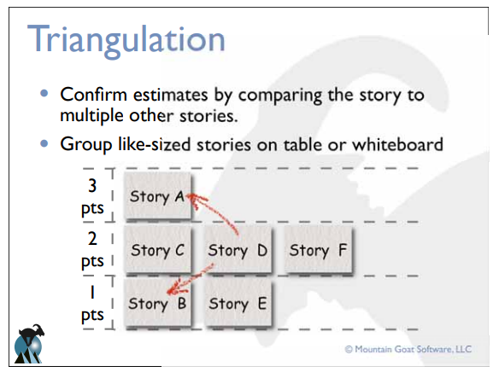
Why Story Points?
Why Story Points?
Study after study shows people are LOUSY at absolute estimation!
Within an order of magnitude, we are VERY good at estimating relative ‘size’
We CAN compare VERY different things using relative sizing, so long as we understand ‘enough’ about each thing.
Comparing a user story to others using Story Points
“This story is like that story, so its estimate is what that story’s estimate was.”
Don’t use a single gold standard
Triangulate instead: Compare the story being estimated to multiple other stories
Size represents
Complexity – how hard is it?
Volume – how much is there?
Knowledge – what do we know?
Uncertainty – what is not known?
9￼
Notes:
Possible Discussion Points:

